Slide 1
職場
趣聞

Slide 2
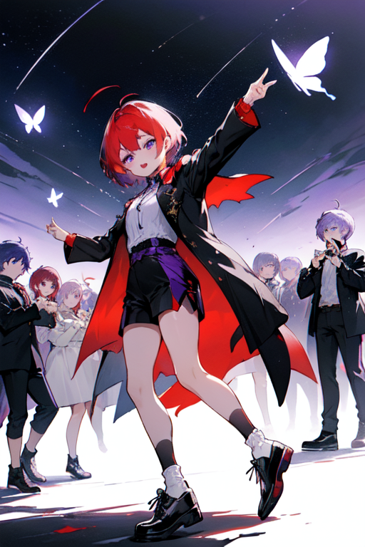
目 標

Slide 3
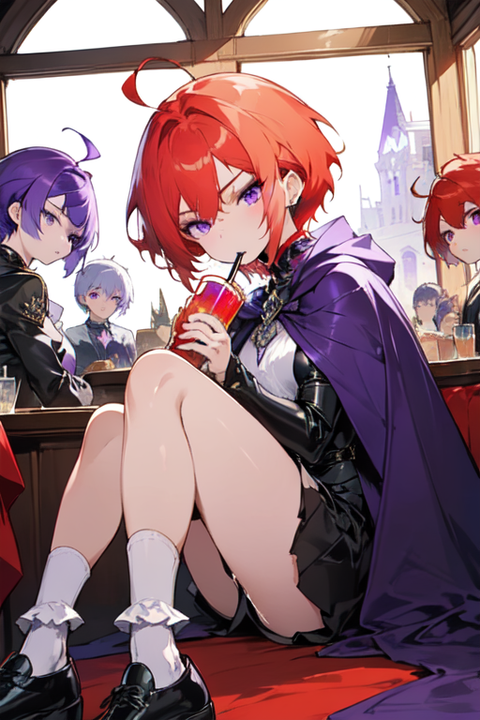
目 標
Notes:
ahoge, (wine-red_hair), short_hair, eyebrow_butterfly, (purple_eyes), dressed in vampire coat, ((short_white_socks)), ((black_footwear)), girl, joyful_expression, dancing, celebration, night, starry_sky, a bunch of game players, quality_up, 1boy, high_quality

Slide 4
目 標
Notes:
ahoge, (Drink-red hair), short_hair, eyebrow jewels, ( (purple-purple eyes) ), wearing a Vampire cape, ( (short white socks) ), (black leather shoes), girl, thinking, expression empty, window seat, looking outside the window, tavern, ( crowd), a group of gamers, quality up,

Slide 5
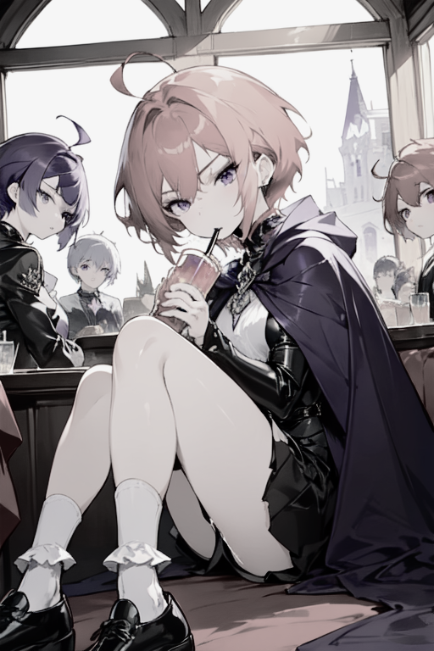
阻 礙

Slide 6
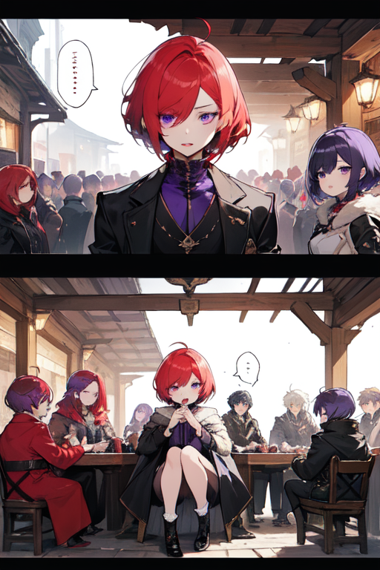
努 力

Slide 7
努 力

Slide 8
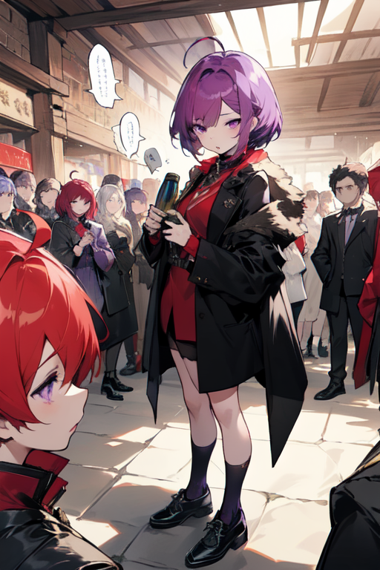
努 力
Notes:
ahoge, (wine_red_hair), short_hair, eyebrowlets, (purple_eyes), vampire_coat, (short_white_socks), (black_footwear), girl, talking, chat, speech_bubble, tavern, lively_discussion, (crowd), bunch_of_gamers, upscale_graphics,

Slide 9
努 力
Notes:
ahoge, (wine_red_hair), short_hair, eyebrowlets, (purple_eyes), vampire_coat, (short_white_socks), (black_footwear), girl, talking, chat, speech_bubble, tavern, lively_discussion, (crowd), bunch_of_gamers, upscale_graphics,

Slide 10
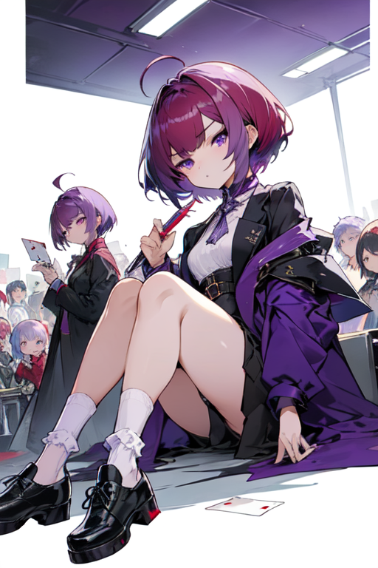
結 果

Slide 11
結 果
Notes:
ahoge, (burgundy_hair), short_hair,-suplid_eyebrows-, ( (purple_eyes) ), wearing a vampire coat, ( (short_white_socks) ), (black_footwear), girl, sitting, pen, expecting expression, card, write_card, ( crowd ), group of gamers, upping the quality,

Slide 12
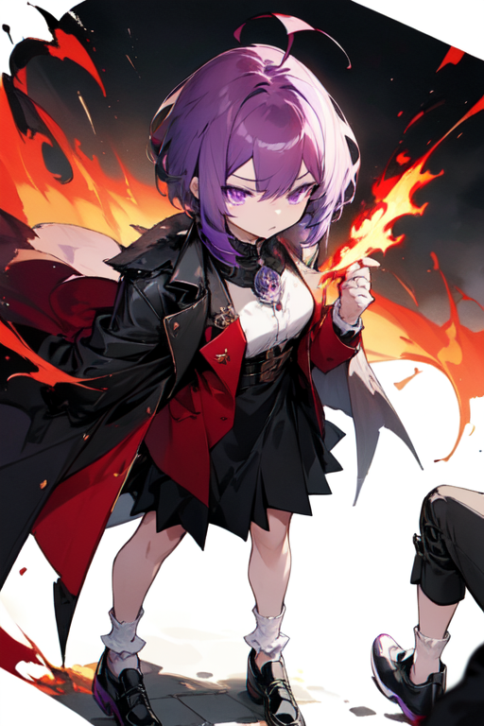
意 外
Notes:
ahoge, (burgundy_hair), short_hair, raised_eyebrows, ( (purple_eyes) ), wearing_vampire_coat, ( (short_white_socks) ), (black_footwear), girl, sad_expression, card, flames, burning_card, (crowd), group_of_gamers, quality_up,

Slide 13
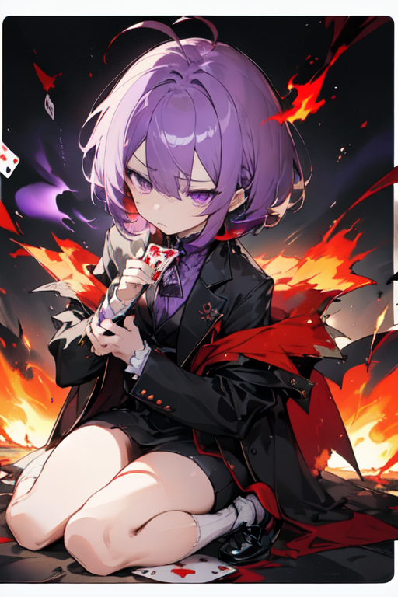
意 外
Notes:
ahoge, (burgundy_hair), short_hair, raised_eyebrows, ( (purple_eyes) ), wearing_vampire_coat, ( (short_white_socks) ), (black_footwear), girl, sad_expression, card, flames, burning_card, (crowd), group_of_gamers, quality_up,

Slide 14

轉 折

Slide 15
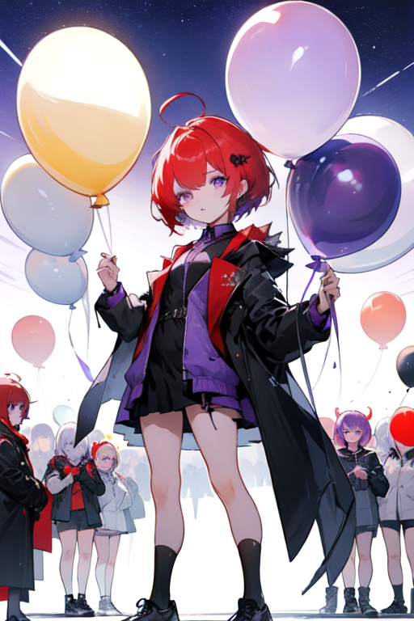
轉 折
Notes:
ahoge, (crimson_hair), short_hair, eyebrowids, ( (purple_eyes) ), wearing a vampire coat, ( (short white socks) ), (black_footwear), girl, people holding balloons, balloons, starry_sky, (crowd), gamer_group, upscaling,

Slide 16
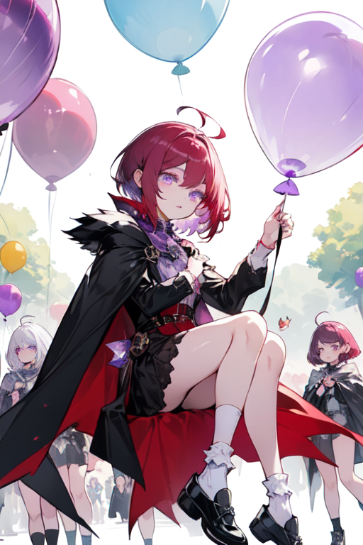
結 局
Notes:
ahoge, (burgundy_hair), short_hair, caterpillar_eyebrows, ( (( amethyst_eyes) )), wearing_vampire_cape, ( (short_white_socks) ), (black_footwear), girl, amusement_park, balloons, expression_of_enjoyment, ( crowd), group_of_gamers, upscale, refine_overlay

Slide 17
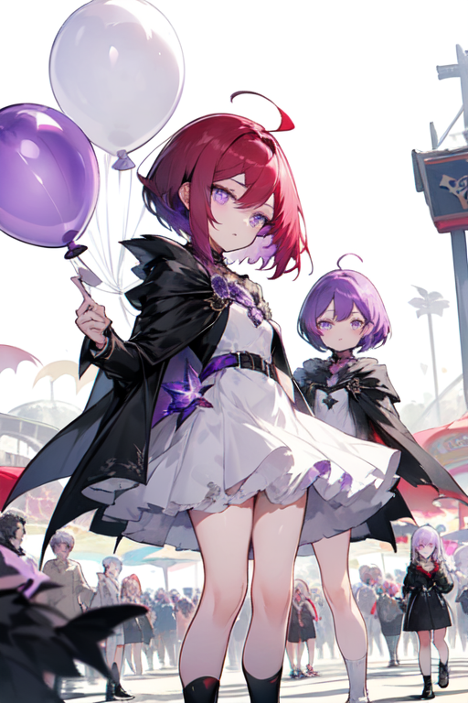
結 局
Notes:
ahoge, (burgundy_hair), short_hair, caterpillar_eyebrows, ( (( amethyst_eyes) )), wearing_vampire_cape, ( (short_white_socks) ), (black_footwear), girl, amusement_park, balloons, expression_of_enjoyment, ( crowd), group_of_gamers, upscale, refine_overlay

